Slide 1
Opportunities for intervention and innovation in the UK food system: the GENIUS (Generating Excellent Nutrition in UK Schools) network
Professor Jayne Woodside, Professor Michelle McKinley, Dr Ruth Hunter Queen’s University Belfast
Professor Ashley Adamson
University of Newcastle
Mr Tim Baker
Charlton Manor Primary School

Slide 2
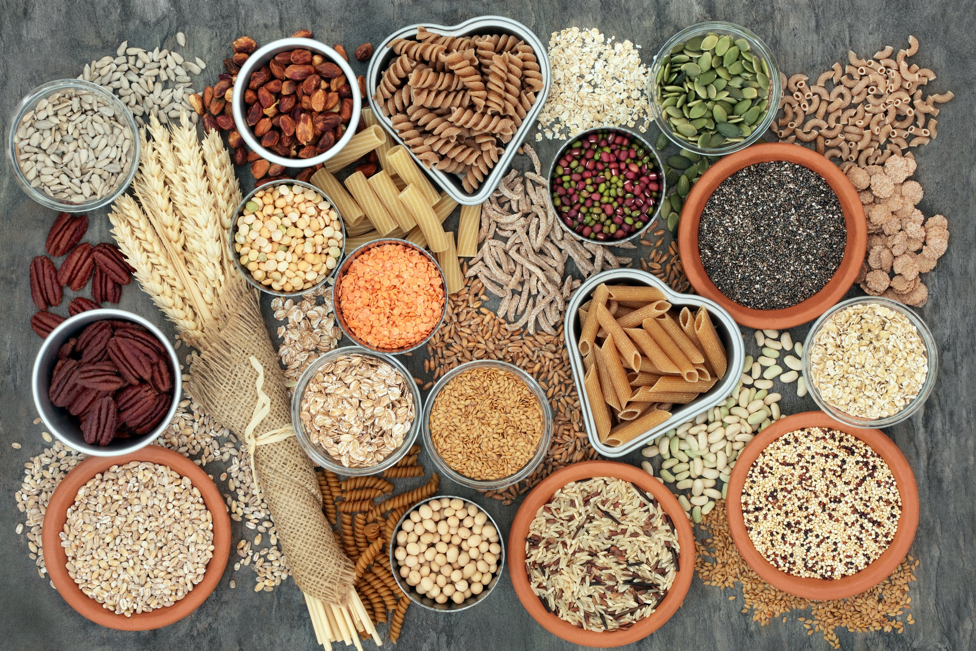
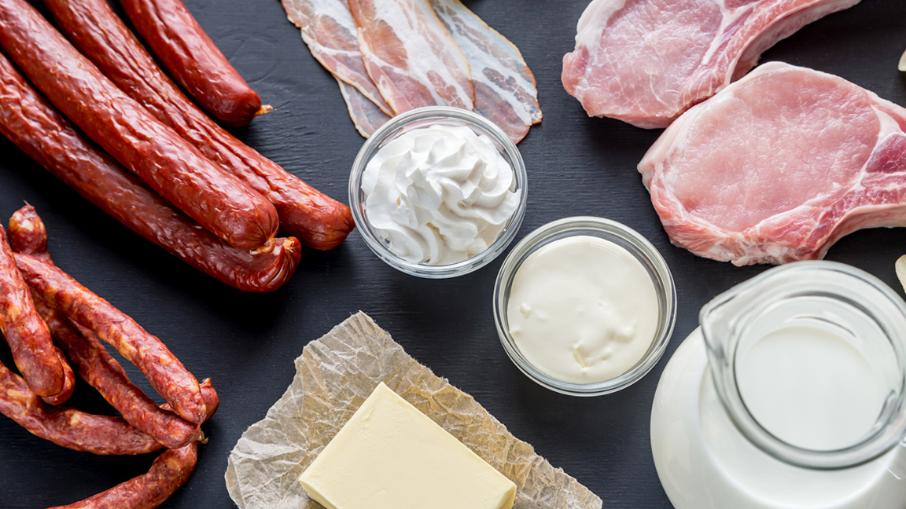
NCD Prevention Challenge
UK children’s diets:
Only 8% of UK 11-18 year olds are meeting the “5-a-day” guideline, with socioeconomic differentials

Slide 3
Overarching aim: to build a community to work towards a more health promoting food and nutrition system in UK schools
Objectives:
Develop a network of academics and project partners working in school food
Use novel research methods to understand the current UK school food system, and appreciate its complexities
Examine similarities/differences/areas of best practice across the UK
Explore opportunities for interventions in a complex system that will positively impact on school food, improve the diet quality of children at school and reduce inequalities

Slide 4
Network members
Researchers: nutrition, epidemiology, public health, sensory science, health economics, health informatics, health psychology, education, complexity science, planning and policy
Project partners: those actively involved in the provision of school food - local government, catering providers, principals, pupils and parents
To ensure network is immediately useful and develops research priorities and questions relevant in the school setting

Slide 5
Network activities
Combination of workshops, working groups and funding of small projects to map the school food system and develop future research priorities and questions
Wide dissemination of findings
Funding applications developed based on the initial co-production of priority areas and research questions to sustain the network in the longer term

Slide 6
Early activities
Administrator appointed
Website being established
Planning first networking/workshop event; March 2020
Establishing governance procedures for pump priming fund awards (>one institution; ≥one project partner)
Systems thinking training, QUB, June 2019
Symposium at Federation of European Nutrition Societies conference, Oct 2019
Symposium proposal submitted to UKSBM, Jan 2020

